Slide 1

Burglar Alarm
(Arduino Module))
Reenu Paul
ELECTRICAL AND COMPUTER ENGINEERING DEPARTMENT
COLLEGE OF ENGINEERING AND APPLIED SCIENCES
UNIVERSITY OF WYOMING

Slide 2


Standards
https://www.nextgenscience.org/pe/1-ps4-4-waves-and-their-applications-technologies-information-transfer
https://www.nextgenscience.org/pe/1-ps4-1-waves-and-their-applications-technologies-information-transfer

Slide 3
Learning Objectives
The goal of this module is to teach students about the properties of sound and computing distance with an ultrasonic sensor.
The program can also be used to measure the relative distance.
This module can also be used in robots for home security or object avoidance.

Slide 4
Module Overview
The main component of the module is the ultrasonic sensor HC-SR04 that sends out pulses that hit an object and reflect back to the sensor. The range of the sensor is about 200 – 400 cm.
The LCD screen displays the distance recorded by the ultrasonic sensor.
When the object (intruder) enters the pre-determined range of the sensor, the buzzer starts beeping at higher frequency.

Slide 5
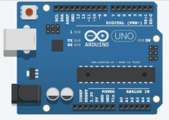
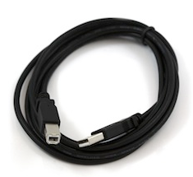
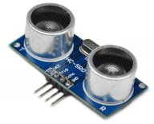
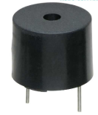
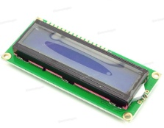
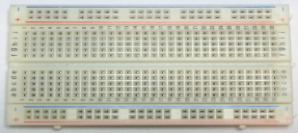
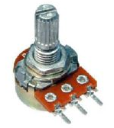
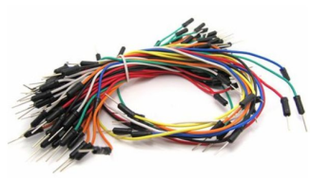
Required Components
1 * Arduino Board
1 * USB cable to attach to PC
1 * Ultrasonic sensor HC-SR04
1 * Buzzer
1 * LCD 1602 Module
1 * Breadboard
1 * Potentiometer
Several jumper wires for connections

Slide 6
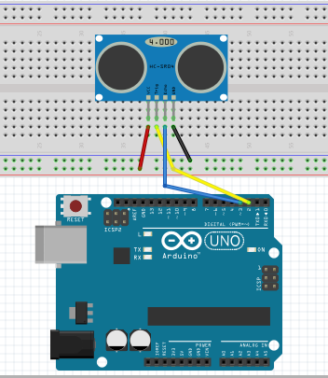
STEP 1: Setting up Circuit
The first component that we will connect is the ultrasonic sensor. The sensor has four pins – Vcc, Trigger, Echo and Ground.

Slide 7
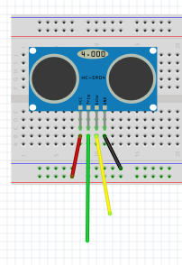
STEP 1: Pin Connections
Pin 3
Pin 2

Slide 8
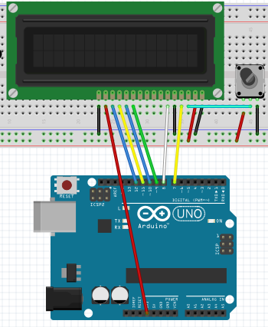
STEP 2: Connecting LCD Screen
The second component that we will connect is the LCD with 16 pins. There are 4 pins that will remain unconnected so please make sure to connect the remaining 12 pins. A potentiometer in connected for LCD contrast.

Slide 9
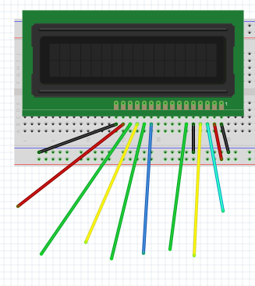
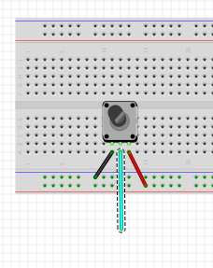
STEP 2: Pin Connections
To 3rd pin on LCD
3.3 V
To middle pin of potentiometer
Pin 11
Pin 9
Pin 8
Pin 12
Pin 10
Pin 7

Slide 10
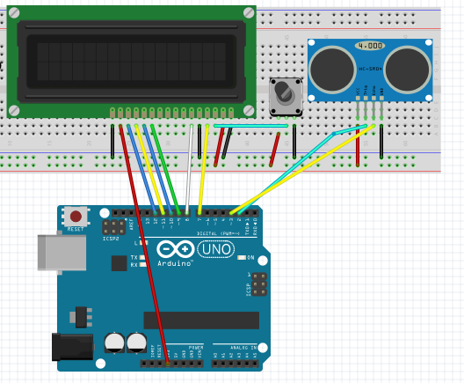
CHECKPOINT 1
At this point, this is what your circuit should look like:

Slide 11
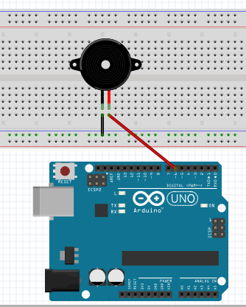
STEP 3: Connecting the Buzzer
Connect the positive terminal to pin 7 and negative terminal to ground. Make sure to avoid switching the terminals.

Slide 12
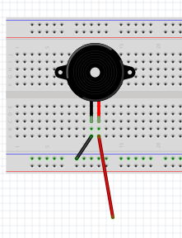
STEP 3: Pin Connections
Pin 7

Slide 13
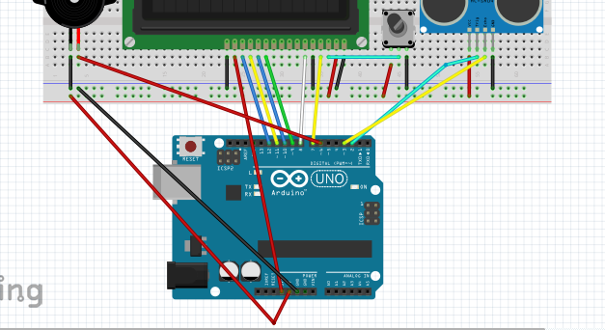
STEP 4: Power the Breadboard
This should be the last step in building the circuit
Power (red wire) to 5V and Ground (black wire)

Slide 14
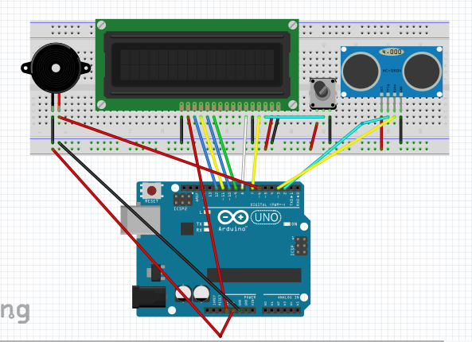
FINAL CHECKPOINT

Slide 15
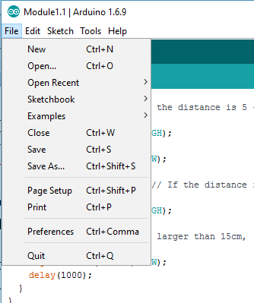
STEP 5: Programming in Arduino
To connect the Arduino to your PC, use the USB cable.
After it is connected, open the Arduino program and under File in the upper left corner, open a new sketch by pressing CTRL+N
Save this new file under a directory you can access and name it whatever you prefer. I have named it Module1.1

Slide 16
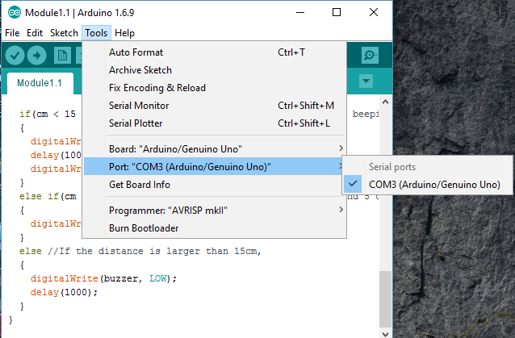
STEP 6: Choosing the COM Port
Make sure your Arduino is connected to your PC.
To select the right COM port, go under Tools on the top bar next to Sketch.
Select the highest number of COM port available
(You may have a different value)

Slide 17
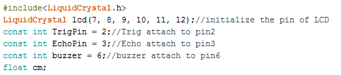
STEP 7: Let’s Begin our Coding!
We must first set up our variables:
To include LiquidCrystal.h (which is a library) go to Sketch and Include Library. Click on Manage Libraries and in the pop-up window, search for LiquidCrystal and make sure it is installed.
The following slides depict the process.

Slide 18
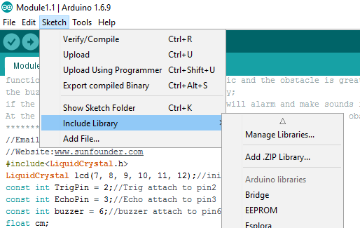
STEP 8: Add Library – Step 1

Slide 19
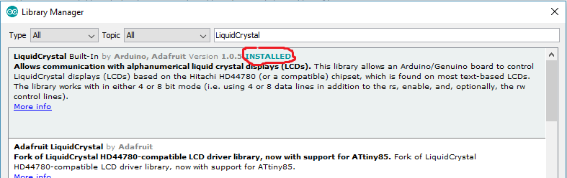
STEP 8: Add Library – Step 2

Slide 20
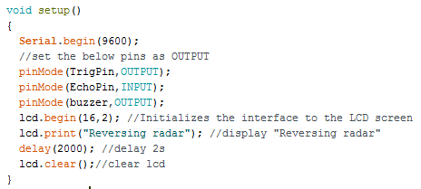
STEP 9: Let’s Continue
The setup( ) function includes code that is executed only once during the program. The buzzer and LCD act as output while the input is the signal received from the EchoPin.

Slide 21
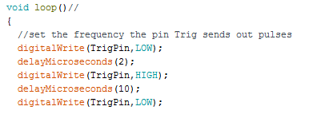
STEP 10: Setting up the Loop( ) Function
The loop( ) function includes code that is executed several times during the program which is crucial for calculating the changing distance of an object.

Slide 22
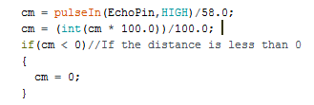
STEP 10: Setting up the Loop( ) Function
Calculations for distance are coded as below. The first line reads the pulses at the Echo pin, and records the time between the pulse becoming high and then turning into low, which is the length of a pulse. Then the length is converted into centimetres.
The second line depicts distance converted from time into a number with two decimal places.

Slide 23
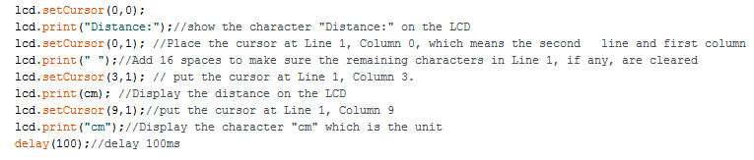
STEP 10: Setting up the Loop( ) Function
The next block describes the coding for the LCD screen

Slide 24
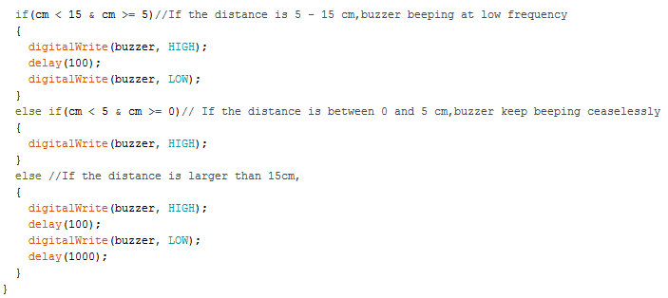
STEP 10: Setting up the Loop( ) Function
The next “if else” block describes when the buzzer will go off:

Slide 25
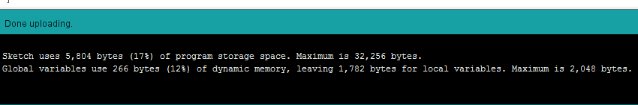
STEP 11: Upload the Code
When you have finished typing up the code, you are ready to now upload it.
To do so, click on in the top bar under File
If the code runs successfully you will see the following snapshot:

Slide 26
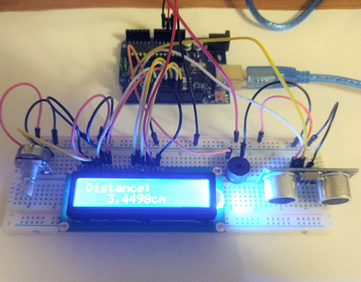
Module in Action

Slide 27
Hints:
You can change the distance for which the buzzer beeps in the third segment of the loop ( ) fuction.
You can also change the frequency of the buzzer such that it beeps after a certain delay.
You can add various forms of output such as LED’s which will turn on at a certain distance.
With this, you can program varying levels of output with different distances.

Slide 28


Common Errors:
A common error while typing out the code is the syntax errors. If you are missing a semi-colon you will probably see an error like this:
Another error is a COM Port issue which will look like this:
To fix that, disconnect and reconnect the USB cable and select the right COM port.
You can also Google any errors but I also encourage you to please contact us if you run into any issues!

Slide 29

GOOD LUCK!!

